Slide 1
CVPS

Slide 2
Agenda
Callibrity
Level Set on Problem Statement & Project Goals
Update on Project Roadmap
After Callibrity
Architecture Details

Slide 3
Callibrity

Slide 4
Mission Statement
Callibrity Standard of Excellence
Modern Code
Tech stack agnostic (whatever the best solution is for our client)
Modern Methods
Agile
DevOps
Test Automation (TDD, CI/CD)
Mindset
Knowledge transfers - “work ourselves out of a job”
Upskilling ourselves
Complement client’s existing skills and abilities
Callibrity
Founded by developers for developers
Callibrity in-house network of experts, blog, lunch n learns etc.
Partnerships
ROI to fund future solutions, most pressing issue first (proof of value)
Notes:
(no one wants to be told they’re doing something “wrong” instead, we take what our clients are doing “right” and we complement and level them up)
(training, conferences, lunch n learns, Callibrity network etc.) and our clients (leading by example)

Slide 5
Problem Statement & Project Goals

Slide 6
Problem Statement & Project Goals
CVPS has built a great self parking solution (Aria)
The product is popular in the market
Aria is in a prime position to dominate market share
However…
Concerns about handling national and global scale
Concerns about ability to onboard new clients
Concerns about ability to add new features
Notes:
Performance, support requests
Setting up new clients
Code base is not extensible

Slide 7
Problem Details
No Multi-Tenancy
Upgrading clients to new versions is difficult
Maintaining existing clients is costly
Adding a new client is cumbersome
Aria machine code requires manual updates
Aria machine code is not extensible for new features
Cloud code is not scalable
Client self service is limited

Slide 8
No Multi-Tenancy
On Premises / On Property - Initial Setup
Property 1
Property 2
CVPS/Aria
CVPS/Aria
Code (v1)
DB (v1)
Code (v2)
DB (v2)
Property 3
Property N
CVPS/Aria
CVPS/Aria
...
Code (v3)
DB (v3)
Code (vN)
DB (vN)
Notes:
Fast to implement
Impossible to maintain

Slide 9
No Multi-Tenancy
Property 1
Property 2
On Premise
CVPS/Aria
CVPS/Aria
Code (v1)
DB (v1)
Code (v2)
DB (v2)
Property 1
Property 2
CVPS/Aria
CVPS/Aria
Code (v1)
Code (v2)
Property 3
Property N
CVPS/Aria
CVPS/Aria
Property 3
Property N
Code (v3)
DB (v3)
Code (vN)
DB (vN)
CVPS/Aria
CVPS/Aria
...
Code (v3)
Code (vN)

Slide 10
DB Machine 1
DB Machine N
Code Machine(s)
DB (v1)
DB (v4)
Code (v1)
Code (v4)
DB (v2)
DB (v5)
Code (v2)
Code (v5)
DB (v3)
DB (vN)
Code (v3)
Code (vN)
Notes:
Does not scale
Versioning is all over the place
Installing new clients is difficult
Every client has a different version
Upgrading is a chore
New clients are time consuming to set up

Slide 11
Aria Code Requires Manual Update
Manually login to each machine
Copy paste new code
Restart if necessary

Slide 12
Aria Machine Code is Not Extensible
Outdated Language - Visual Basic
Hard to develop against
Hard to find developers willing to work on it
Not always compatible with hardware
Zero Test Coverage
Clients find bugs instead of us
Adding new features breaks existing features
Spend time dealing with production problems instead of adding new features
Code base not built to handle rapid success
It has become difficult to add to the code base without breaking things

Slide 13
Cloud Code is Not Scalable
Multiple versions of code and properties on a single machine
Can only scale up
Get a bigger machine
$$$

Slide 14
Client Self Service Limited
Clients cannot easily adjust settings
Rates
Etc.
Clients must put in support request
This is costly

Slide 15
Roadmap

Slide 16
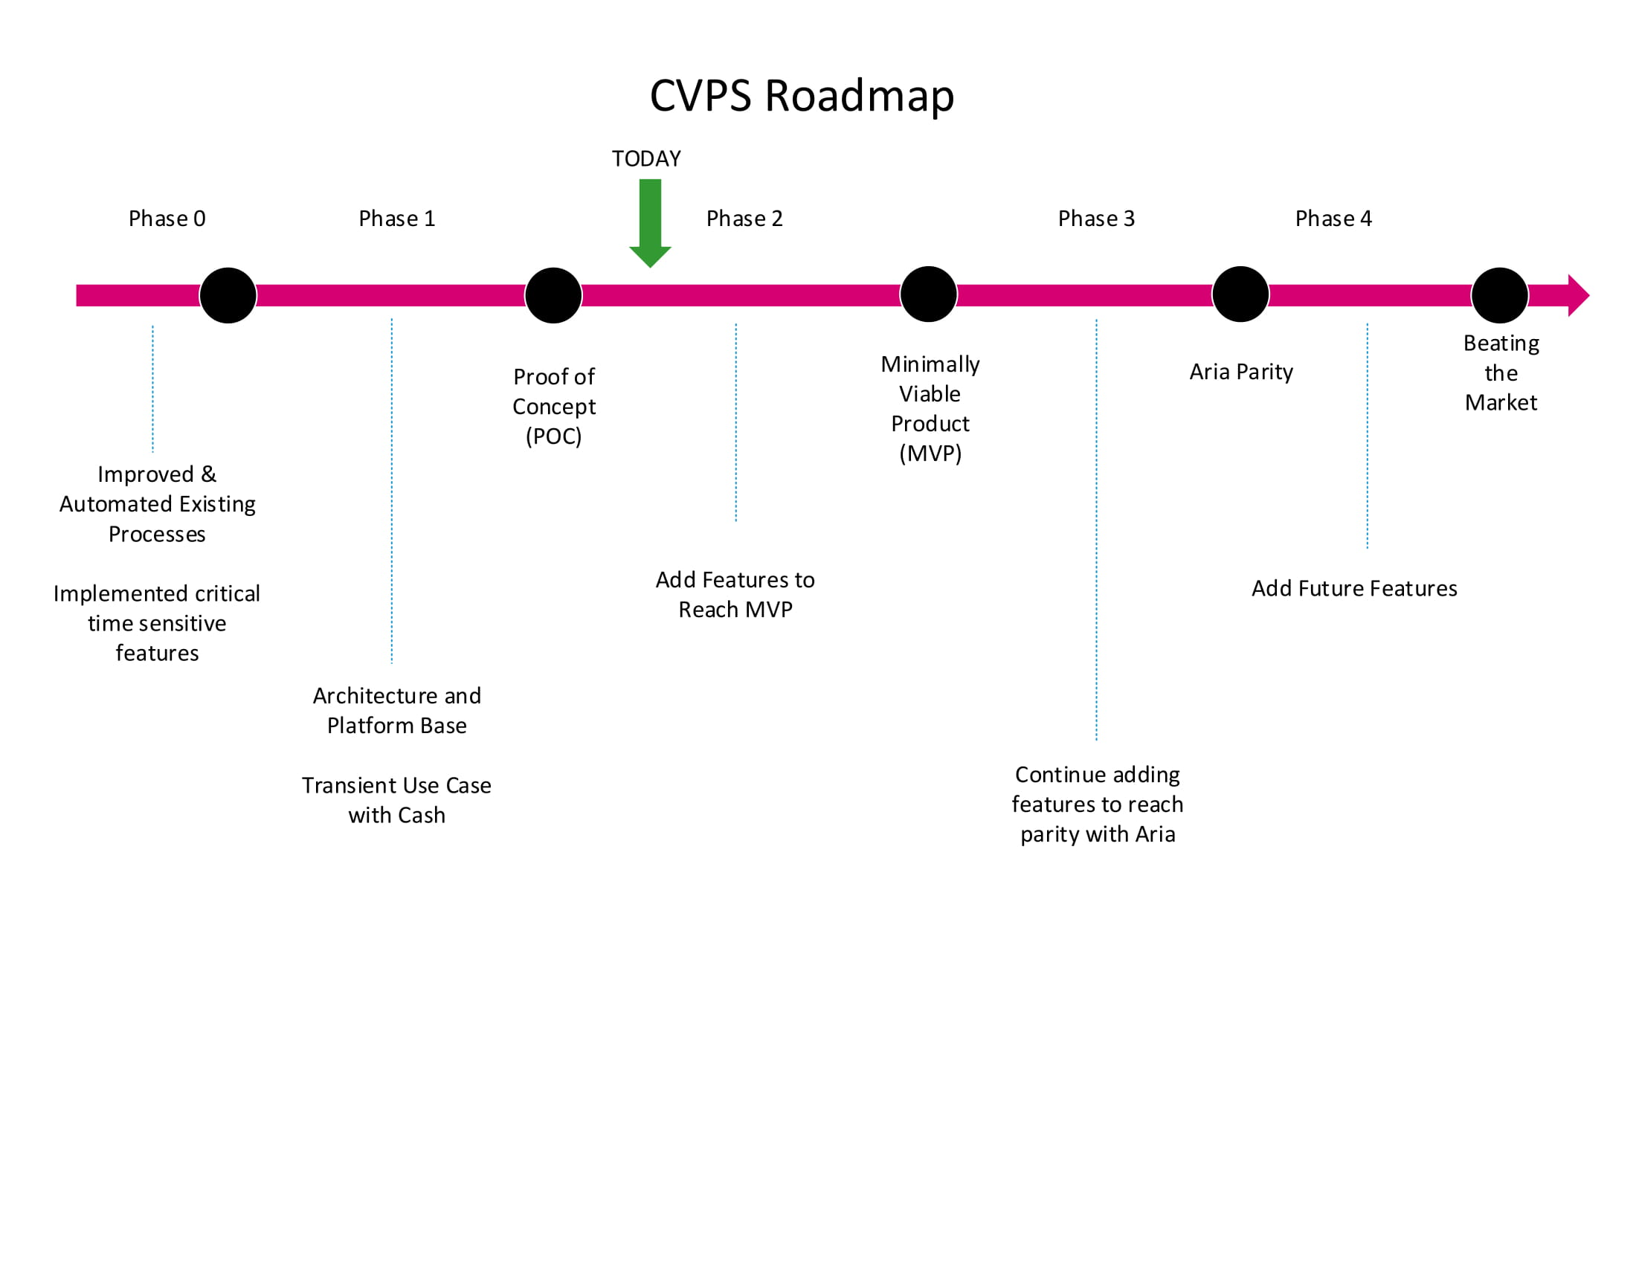

Slide 17
Phase 0 - Stabilize Existing Product
✓ Automated Portions of Existing New Property Setup Process
✓ Implemented High Value Features on Existing Code Base
✓ Cash
✓ Integration with 3rd Party Reporting Service
✓ COMPLETE

Slide 18
Phase 1 - Proof of Concept (POC) / Platform
✓1. Transient Use Case with Cash
✓2. Solve barriers to new installation and feature requests
✓Allow for Aria to auto update
✓Modernize Aria codebase
✓Create a multi-tenant database architecture
✓Authentication/Authorization
✓Implement Best Practices for software as a service & cloud infrastructure
COMPLETE at end of January

Slide 19
Minimally Viable Product (MVP)
Goal: Deliver an experience that can be sold & installed
✓ 1. Choose a Property to Reach Parity With (Fountain Place)
✓ 2. Add Features in Priority Order at John’s Direction
✓ Additional Devices (Credit Card, Height Sensor, RFID, etc.)
✓ Handle all Rate Options
✓ Monthly Parking
✓ Lost Ticket
✓ Portal Improvements
✓ Additional Features...
Notes:
Should we put a target date on here?

Slide 20
Aria Parity
Implement any features that Aria has that were not in MVP
Design plan for cutover of existing clients to new system

Slide 21
Beating the Market
Continue to add features to acquire additional clients
Offline Mode
Internationalization
Multiple Currencies
Display in Multiple Languages
Future Features

Slide 22
After Callibrity

Slide 23
After Callibrity
GOAL: CVPS & Amano can support and add to this project after Callibrity is finished
HOW:
Callibrity involves CVPS in as many decisions as possible early in the process
CVPS works alongside Callibrity to deliver the product

Slide 24
Architecture Details

Slide 25
Properties
Cloud (AWS)
Property 1
Property 2
API Gateway
Services
Database(s)
Rates
Property 3
Property 4
Multi Tenant Database
Property 5
Property 6
Ticket
Property 7
Property N
Web Portal
Settings
Web Portal Users

Slide 26
Property
Cloud (AWS)
Aria 1
Aria 2
API Gateway
Services
Database(s)
Rates
Multi Tenant Database
Aria 3
Aria N
Ticket
Web Portal
Settings
Web Portal Users

Slide 27
Aria Unit
Cloud
Aria Front End
(React Application)
Responsibilities:
UI
Respond to Events from Aria Server
Aria Daemon
(.NET Core 3)
Responsibilities:
Initially installed in factory
Keeps Aria Front End and Server Up to Date
Installs drivers for devices
Starts up and keeps alive Front End and Server
Reports Status of Aria to Server
API
Multi Tenant Database
Aria Server
(.NET Core 3)
Responsibilities:
Interface w/ Hardware Devices
Interface with Cloud API
Status of Devices
Notes:
Aria Server
Handles hardware interaction (gate, cash, barcode, etc)
Handles communication between terminal and cloud resources
Separate from presentation service to ensure background tasks don’t affect responsiveness of the User Interface
Aria Daemon
Keeps software on the Aria Terminal up to date
Software version determined by the Settings Service
Can be set to update at a specific time to minimize downtime
Communicates Success / Failure of update, automatic roll back on failure
Installs Aria Terminal software on new Terminals
Insert Flash Drive, Double Click ‘AriaInstaller.exe’
Aria Front End
The user interface of the Aria product
Built with React, a popular and actively developed web technology
Quick, responsive, built to allow features to be added quickly

Slide 28
Web Portal
Single Page Application
A single web page for all interaction with the Aria Platform
Access controlled via accounts / passwords
Possible to add tokens, three factor, etc
Features shown on the web page are based on user privileges
What a user can access / do is very granular
Single page reduces effort / complexity
Easier to onboard
Responsive
http://aria-portal-static-dev.s3-website.us-east-2.amazonaws.com/
Web Portal
Aria Device Status
Client Management
Client Self Service
Self-Parker Access

Slide 29
API Gateway
A single place for non-humans to access and interact with the aria platform
Single place for ingress of all traffic
Allows for simpler monitoring and tracking
Scalable
Stateless - no data is stored, allowing many instances to be running simultaneously
3rd Party Integration
Industry standard RESTful interface makes integrating with third party services and providers a straightforward process
Easier to test
Each endpoint can be tested with each change, insuring changes to the platform will not break existing functionality
API Gateway
API Gateway

Slide 30
Services
Services
Database(s)
Microservices
Each microservice does one thing, and does that one thing well
Easy to scale
Easy to test
Easier to add new features
Faster Development Time
Easier to customize for special clients
Database
Rates
Database
Ticket
Database
Settings

Slide 31
Multi-Tenant Databases
Database(s)
DB Machine 1
DB Machine N
DB (v1)
DB (v4)
Multi Tenant Database
(vN)
DB (v2)
...
DB (v5)
DB (v3)
DB (vN)

Slide 32
Multi-Tenant Databases
Each Database hosts multiple Clients
New clients can be added instantly, without human intervention
One version of each database used by all Clients
Simplifies updates / maintenance
Database Resources can be scaled dynamically
Pay for resources only when needed
Separate databases for operational vs non-operational data
Customize type of data storage based on specific needs
Tickets - Fast, often changing ( cosmos? )
Other stuff - Sql - pretty fast
Old Tickets - Cold storage
Only place data is saved
Makes backups, reporting, security easier

Slide 33
